Slide 1


arcatech
… testing tomorrows telecom
V5 Local Exchange Simulator
emutel|Virtuoso

Slide 2
arcatech
… testing tomorrows telecom
Agenda
Virtuoso
  Overview
  Rack Application
  Analyser Application
Applications
Demonstration

Slide 3
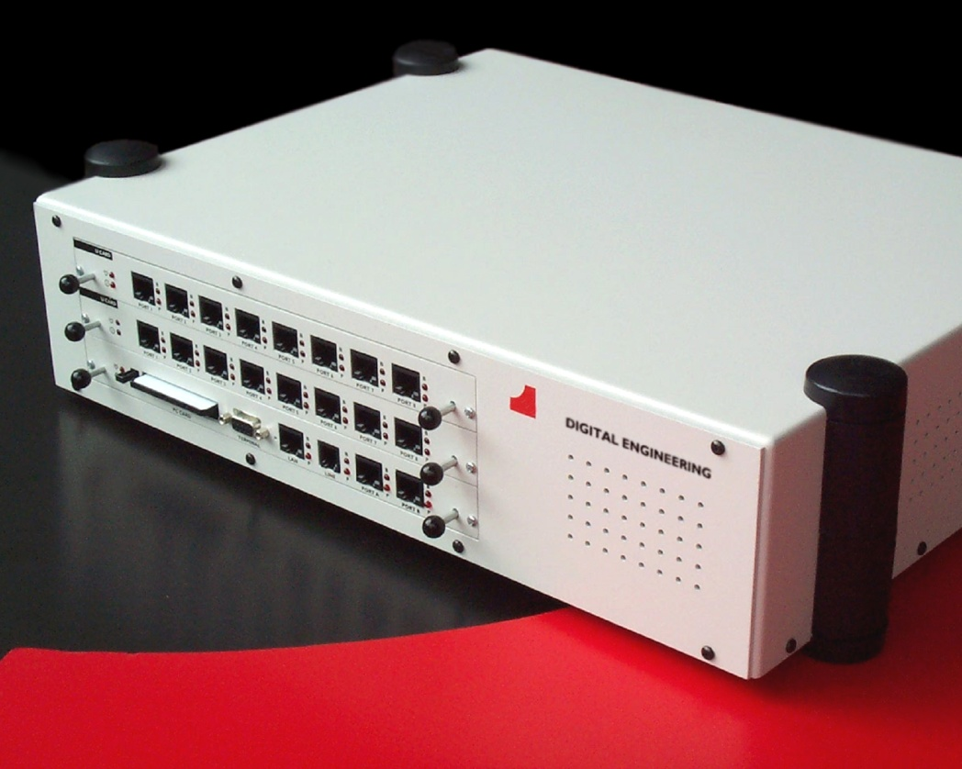
arcatech
… testing tomorrows telecom
Emutel™ Virtuoso

Slide 4
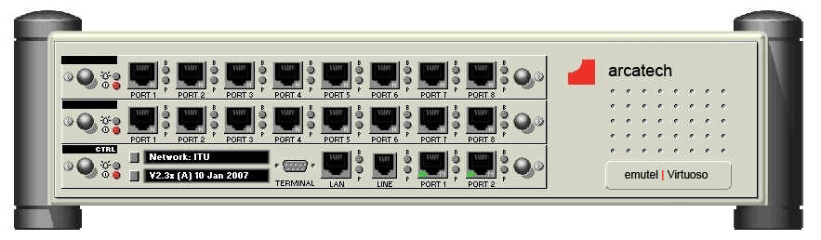
arcatech
… testing tomorrows telecom
Configuration
C
B
A
Emutel™ | Virtuoso | A (standard controller card) | B (standard slot-in card) | C (standard slot-in card)
Interface type | Optional: 2x BRI-S 2x BRI-U 2x E1/T1 | 8x BRI-U or 8x BRI-s or 8x E1/T1 or 16 PSTN | 8x E1 Links
Software | ISDN |  | V5.1 only, V5.2 only Both V5.1 and V5.2
Protocol Analyser | Optional

Slide 5
arcatech
… testing tomorrows telecom
Software Applications
V5 Rack Application
  Used to connect to the emutel™|Virtuoso hardware, to configure the units settings & communicate with the Access Network
Analyser Application
  Used to display the decoded packets on to the PC screen. Will also setup all filters and analyser settings

Slide 6
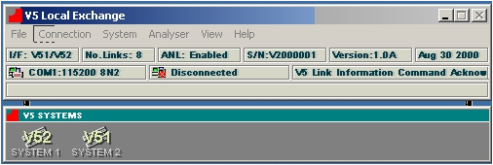
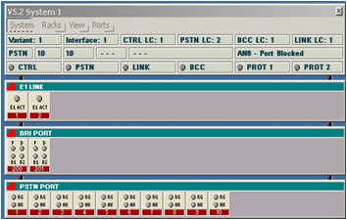
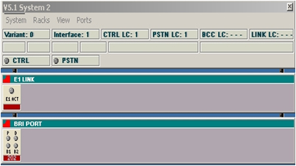
arcatech
… testing tomorrows telecom
V5 Rack Application

Slide 7
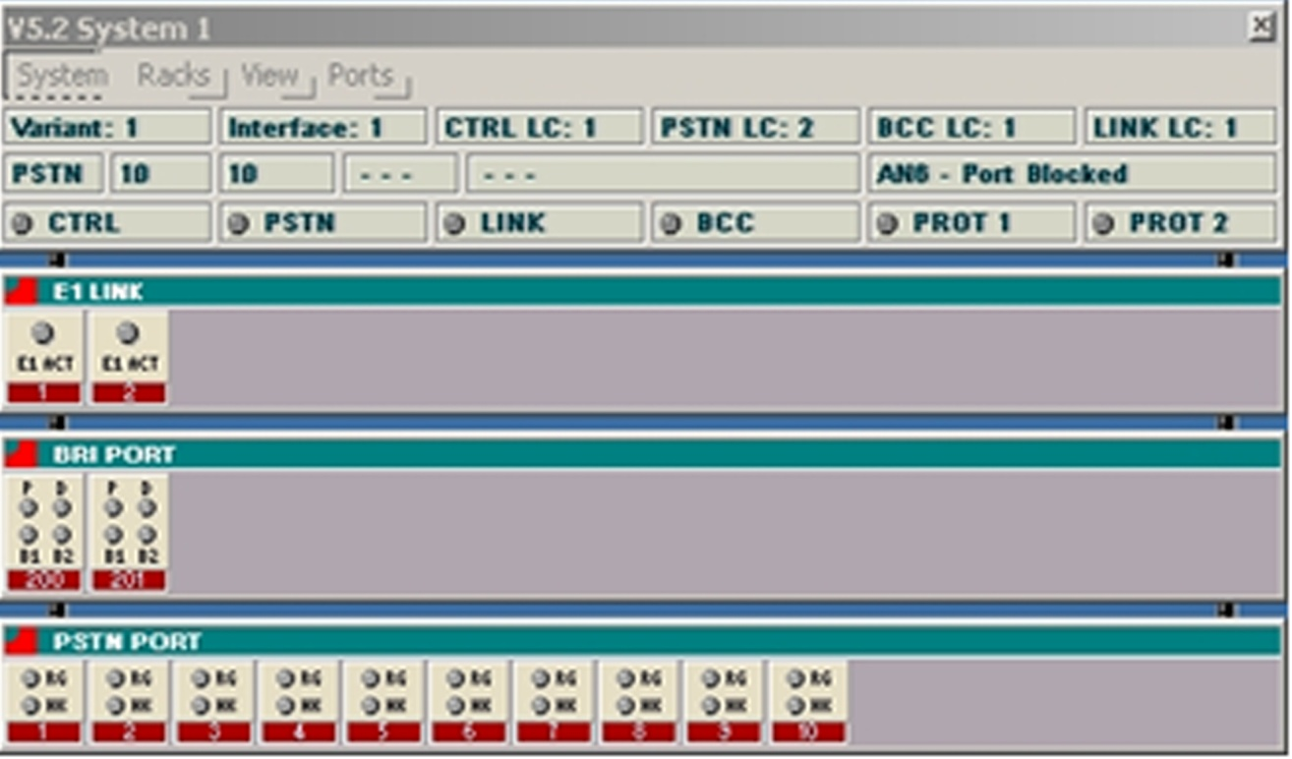
arcatech
… testing tomorrows telecom
V5 Rack Application

Slide 8
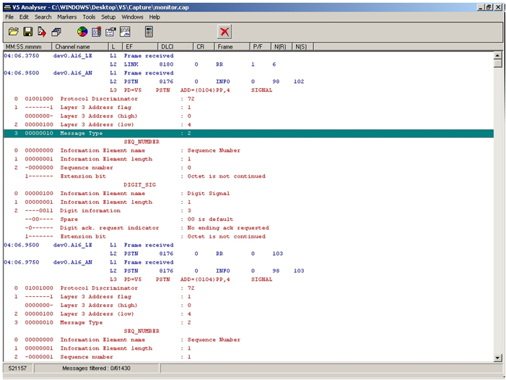
arcatech
… testing tomorrows telecom
Analyser Application Main

Slide 9
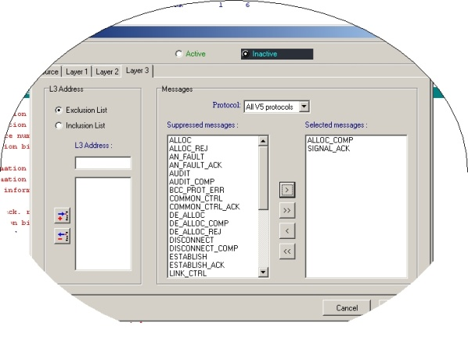
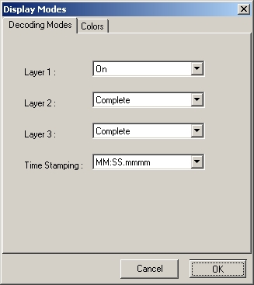
arcatech
… testing tomorrows telecom
Analyser App Filters
Pick specific messages for personally designed filters
Use general settings for layer detail

Slide 10
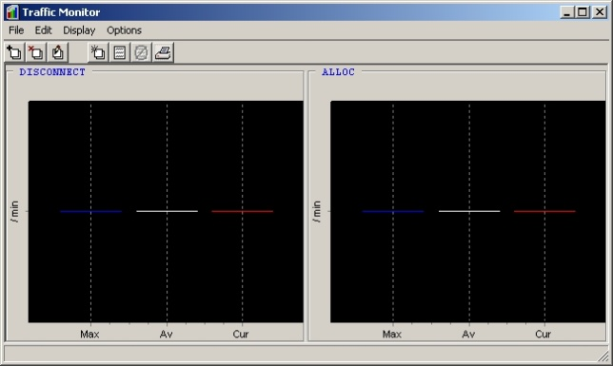
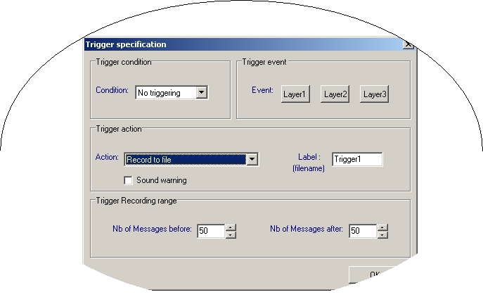
arcatech
… testing tomorrows telecom
Analyser App Filters
Activate traffic monitors on specific message types
Use triggers in initiate analyser

Slide 11
arcatech
… testing tomorrows telecom
Applications
Useful to - Telecommunications V5 developers
Purpose - To give developers of Access Networks a cost effective solution to test against a Local Exchange.
Reason - The cost of a real V5 Local Exchange is expensive for any company developing V5 Access Networks or V5 applications.

Slide 12
arcatech
… testing tomorrows telecom
Applications
Useful to - Telecomm manufacturers / resellers
Purpose - To enable manufacturers and resellers to demonstrate Access Networks to customers on-site and at exhibitions
Reason - When a supplier of an Access Network needs to demonstrate their equipment at an exhibition or at the customer’s site this requires a local exchange to be present. A V5 Local Exchange is bulky, expensive and wasteful of valuable resources for this task.

Slide 13
arcatech
… testing tomorrows telecom
Applications
Useful to - Telecomm manufacturers and developers / Service Providers
Purpose - Access Network Verification
Reason - Due to the high demand for reliable telecommunications equipment, developers and manufacturers need to be able to stress test their equipment. Could also be purchased by a Service Provider to test how good an AN is before purchasing it.

Slide 14

arcatech
… testing tomorrows telecom
Block Diagram
V5 LE + ISDN Network
Emutel™|Virtuoso
V5.1 Access Network
Acacia
Clarinet
Ascom Eurit 30

Slide 15
arcatech
… testing tomorrows telecom
Contact Us at…
arcatech Ltd
210-212 Enterprise Centre
Ballinderry Road
Lisburn
BT282SA
UK
+44 (0) 28 92 677 204
sales@arcatech.com
www.arcatech.com

Slide 16
arcatech
… testing tomorrows telecom
Thank You
The End

