Slide 1
ISDN PRODUCT GUIDE
emutel|Solo
arcatech Limited
Unit 402 LEO Ballinderry Road
Lisburn
Northern Ireland
BT28 2QA
Tel: +44 (0)28 9267 7204
Fax: +44 (0)28 9260 5353
sales@arcatech.com
www.arcatech.com

Slide 2
Presentation Content
Solutions from arcatech Limited
Who is the emutel range used by
emutel|Solo features
Summary of features
Typical Applications
Other Products available from arcatech

Slide 3
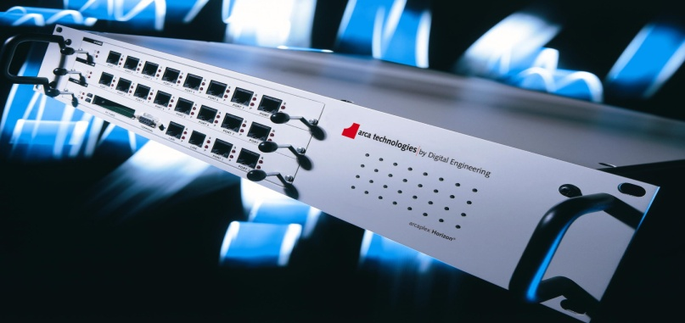
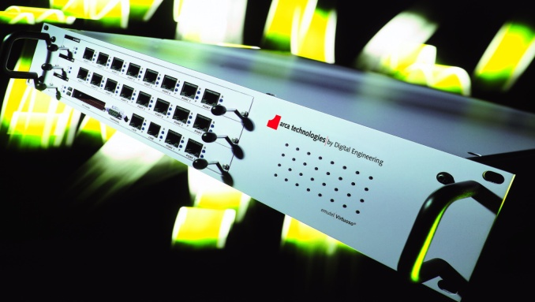
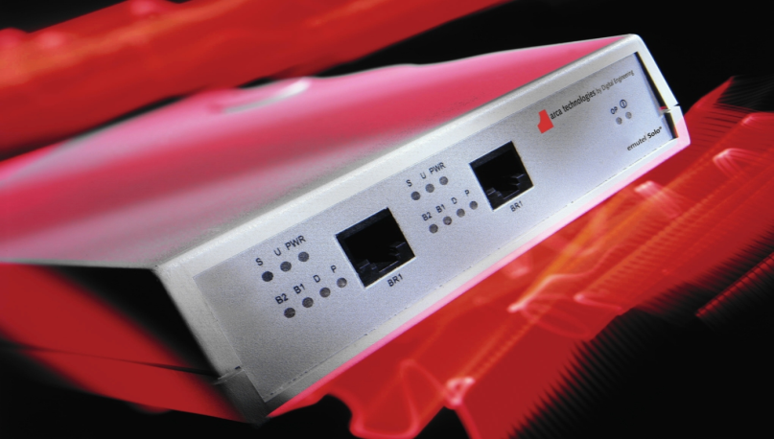
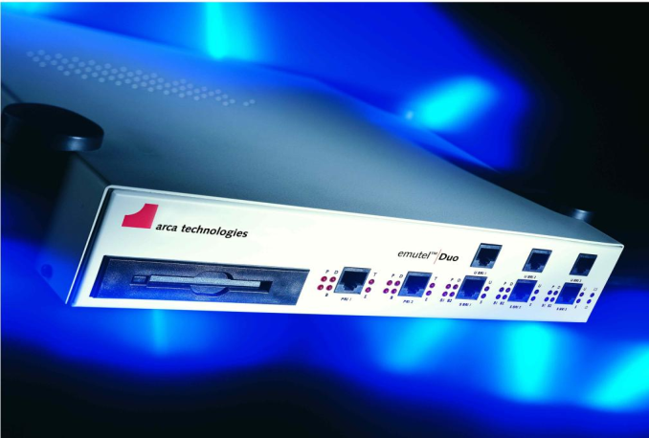
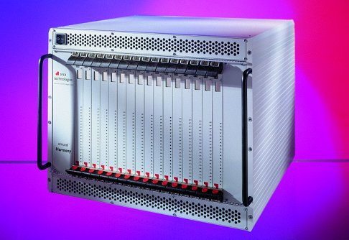
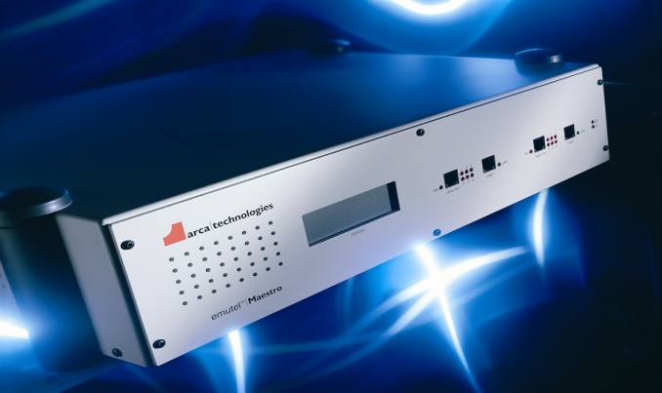
Solutions from arcatech Limited
ISDN
POTS
V5
xDSL
VoIP
Horizon
Symphony
Solo
Duo
Harmony
Maestro
Harmony

Slide 4
Typical Customers

Slide 5
The emutel range is used by
Developers
ISDN
xDSL
VoIP
Production Line Testing
TE equipment
Modems
SIP/H.323 Gateway
Repair Houses
Confirm operation
For ISDN Network provision
Exhibitions/Shows
Teaching facilities
Labs

Slide 6
emutel|Solo – 2 Port Basic Rate ISDN Network Simulator
A
B

Slide 7
Unit Features
BRI Ports
2 Ports, each software switchable between BRI-S and BRI-U
BRI Interface Power
40V, 1W Normal and Restricted on BRI-S
55V, 1.5W Normal and Sealing on BRI-U
Network Variants
Support for ETSI, N.America and NTT
D Channel Packets
X.25 on BRI1/BRI2
100 logical calls in DCE mode
P-P / P-MP
Point-to-point or point-to-multipoint modes can be selected

Slide 8
Unit Features
Semi-permanent connection (Leased Line)
Semi-permanent/nailed up IDSL connection on BRI B and D channels (144K
connection)
B Channel Delay
0-750ms delay on Port 1, B1 and B2 independently
Telephone no. setup
Allows telephone numbers to be setup for the various ports
Also allows different numbering schemes to be used (i.e. MSN, normal, DDI &
auxiliary)
Test Tones
Dial, Busy, Error, Ring, and Custom Tone 300Hz-3400Hz @ +3dBm to -26dBm

Slide 9
Unit Features
Port Indicators
P (Physical), D(Datalink), S/U operation and port power status, B channel status
Internal battery
An internal rechargeable battery to power the unit
Universal PSU (110/240 V)
Auto detecting PSU - no changes required to alter voltage input, can be used in
different countries

Slide 10
Summary of Features

Slide 11
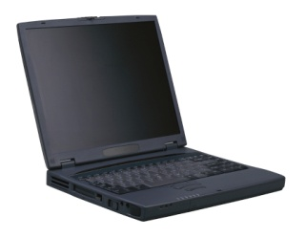
Typical Application
In this example, an emutel|Solo is providing a network interface to verify the operation of a piece of customers equipment.
Controlling PC
ISDN Telephone
ISDN PBX
ISDN Telephone

Slide 12
Other products available from arcatech
emutel|Harmony
VoIP
ISDN
FXO
FXS
emutel|Symphony
FXS
ISDN
emutel|Duo
ISDN
arcaplex|Horizon
Multiplexer
ISDN
FXS
emutel|Maestro
xDSL
arcareach|Sigma
BRI-S bus extender

Slide 13
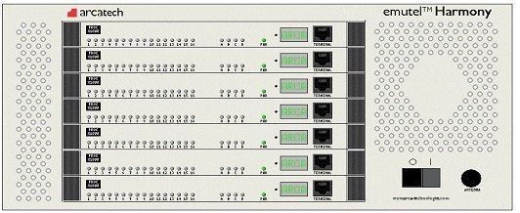
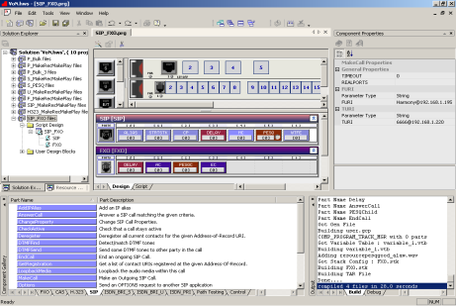
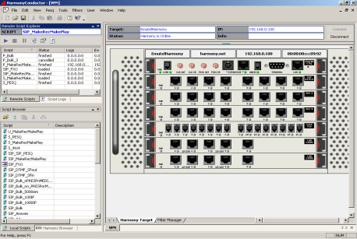
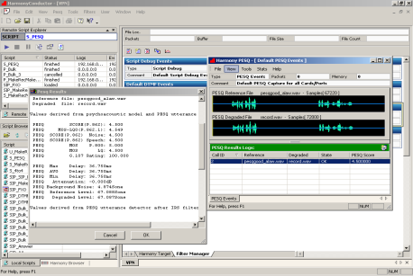
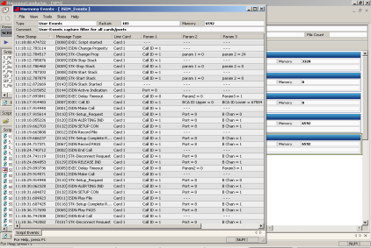
emutel|Harmony
Integrated VoIP & TDM Test Platform
High Port Density
VoIP, BRI, PRI, LAN, FXO, FXS
ETSI, North American, NTT, SIP, H.323
Quality of Service (PESQ)
Protocol Analysis
Call Generation
Call Termination
Network Simulation
Composer
Conductor
Events &
Statistics
PESQ

Slide 14
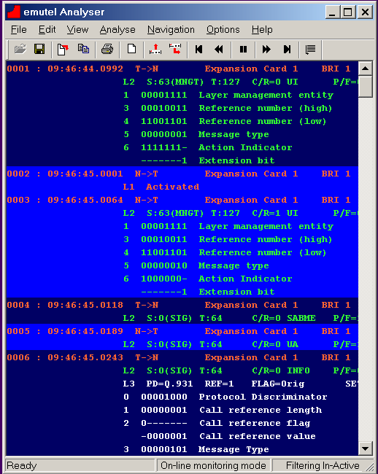
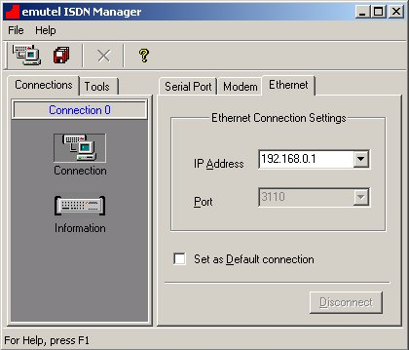
emutel|Symphony
Medium Port Density
ISDN support, both BRI and PRI
Analogue FXS support
Support for Network Variants
Protocol Analyser
Remote configuration
Windows Application driven
Analyser
Connection configuration

Slide 15
emutel|Duo
Low Port Density
ISDN support, both BRI and PRI
Support for Network Variants
Protocol Analyser
Remote configuration
Windows Application driven
Analyser
Connection configuration

Slide 16
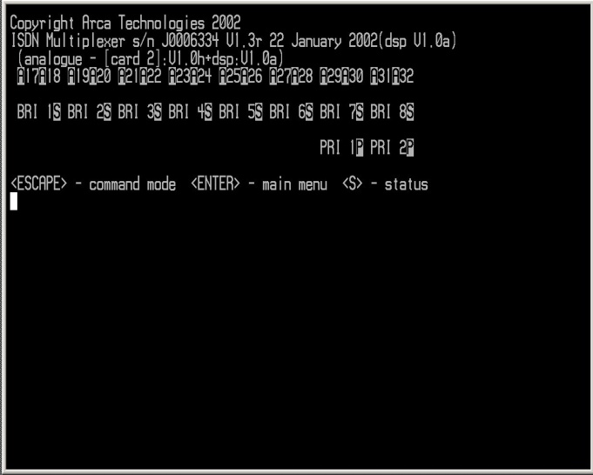
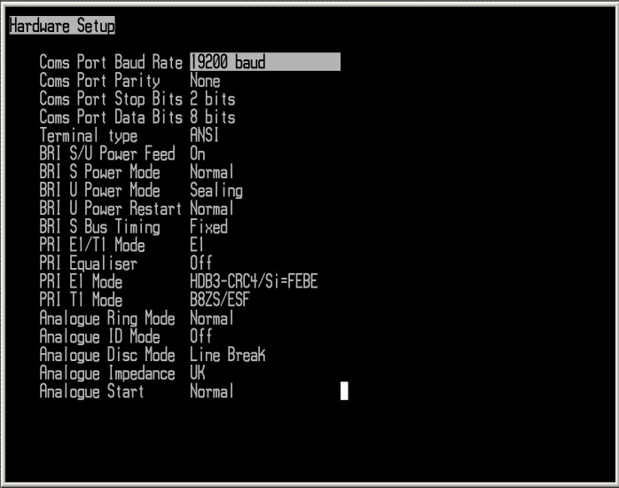
arcaplex|Horizon
PRI – ISDN/Analogue Multiplexer
Allows an E1 or T1 Network to be used with up to
16xBRI or 32xAnalogue phones
PRI network port allows for connection to another
Horizon or PRI TE equipment
CLI Interface

Slide 17
arcareach|Sigma
Converts BRI-S to BRI-U
When used in conjunction with an NT-1
enabling the extension of an S-bus up to 5.5km

Slide 18
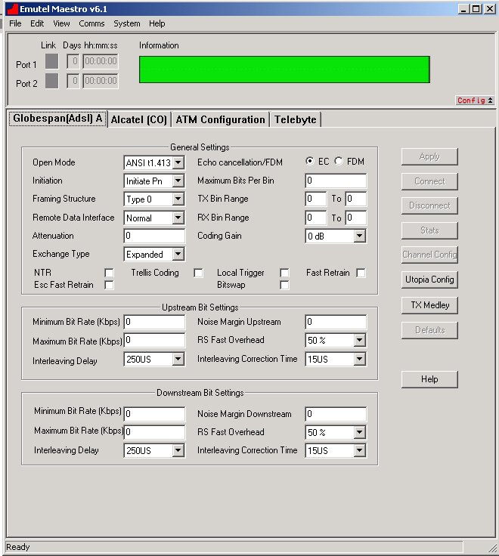
emutel|Maestro
Support for
ADSL (Annex A,B,C)
SHDSL
VDSL
Data Sources
ATM
Ethernet
Internal Web server
Windows Application
Configuration of Bandwidth,
upstream and downstream
Windows Application

Slide 19
The End

