Slide 1
arcatech
…testing tomorrows telecoms
xDSL PRODUCT GUIDE
emutel™|Maestro
arcatech Limited 210-212 LEO Ballinderry Road
Lisburn
Northern Ireland
BT28 2QA
Tel: +44 (0)28 9267 7204
Fax: +44 (0)28 9260 5353
sales@arcatech.com
www.arcatech.com

Slide 2
arcatech
…testing tomorrows telecoms
Presentation Content
Solutions from arcatech Limited
Who is the emutel range used by
emutel™|Maestro features
Typical Applications
Other Products available from arcatech

Slide 3
arcatech
…testing tomorrows telecoms
Typical Customers

Slide 4
arcatech
…testing tomorrows telecoms
The emutel range is used by
Developers
ISDN
xDSL
VoIP
Production Line Testing
TE equipment
Modems
SIP/H.323 Gateway
Repair Houses
Confirm operation
For ISDN Network provision
Exhibitions/Shows
Teaching facilities
Labs

Slide 5
arcatech
…testing tomorrows telecoms
emutel|Maestro – xDSL network simulator
xDSL Chipsets supported:
ADSL
Alcatel
Globespan Annex A,C
Texas Instrument Annex A,B
SHDSL
Globespan
VDSL
Infineon

Slide 6
arcatech
…testing tomorrows telecoms
Unit Features
Independent xDSL ports
ADSL
SHDSL
VDSL
Multiple manufacturers chipsets
Interoperability testing possible
Chipset specific configuration
Access to chipset specific configuration parameters
Connection to real line
Enables connection to real POTS or ISDN lines
Connection to external data source
10Base-T and ATM 155 connections to outside world

Slide 7
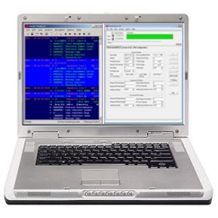
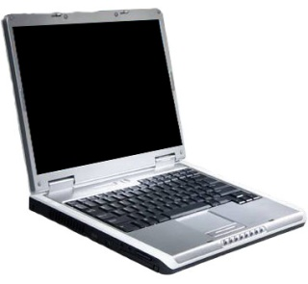
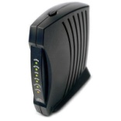
arcatech
…testing tomorrows telecoms
Typical Application
In this example, an emutel|Maestro is providing a ADSL link to verify the operation of a piece of customers equipment. The windows application provides ease of configuration and Analysis
ATM/Ethernet server
Customers Modem under test, connected to PC
PC for control of maestro

Slide 8
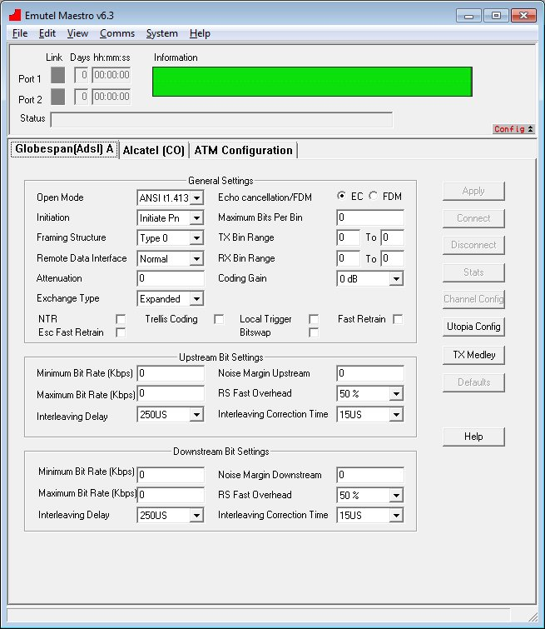
arcatech
…testing tomorrows telecoms
User Interface
Options that can be changed on the Globespan Modules
Different modes of operation can be specified :- G.Lite, G.DMT and others
Bit Rate speeds can be altered for both Upstream and Downstream. This allows for testing of a modems capability to train up at slower speeds.

Slide 9
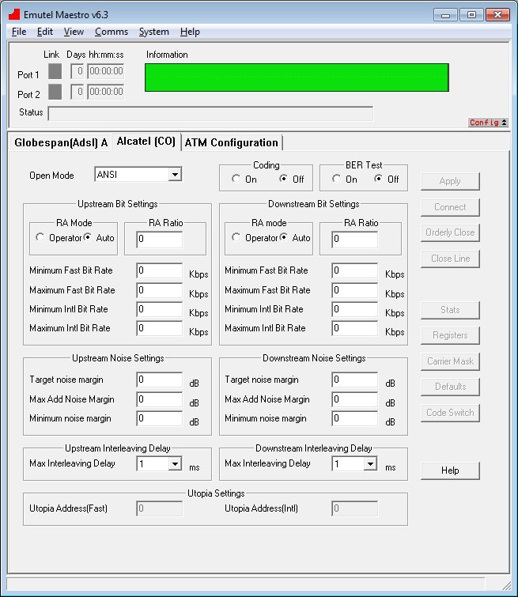
arcatech
…testing tomorrows telecoms
User Interface
Options that can be changed on the Alcatel Module
Similar to the Globespan modules, different modes of operation can be specified :- G.Lite, G.DMT and others
Bit Rate speeds can be altered for both Upstream and Downstream. This allows for testing of a modems capability to train up at slower speeds.
Other modules that are available for the Maestro have the same capabilities for altering the obtainable connection speeds.

Slide 10
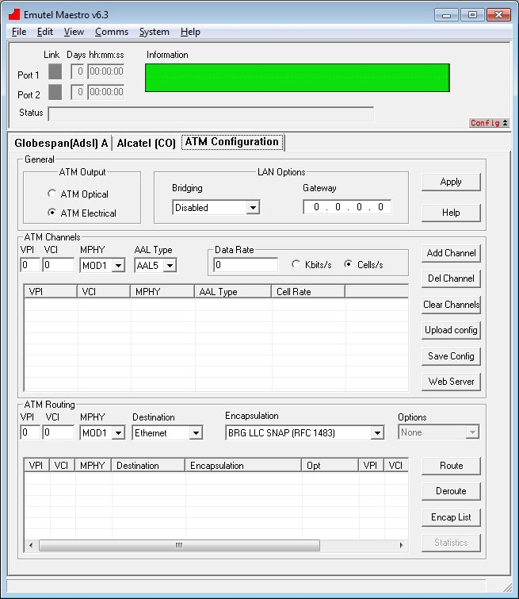
arcatech
…testing tomorrows telecoms
User Interface
Data sources of the Maestro can be configured within the ATM tab
There are a number of sources from which data can be taken for each ADSL module within the Maestro.
The Maestro has an internal webserver which allows for some basic upload and download testing.
The Maestro has an Ethernet port and ATM155 Optical and Electrical ports which can be connected to external equipment to be used as the data source.

Slide 11
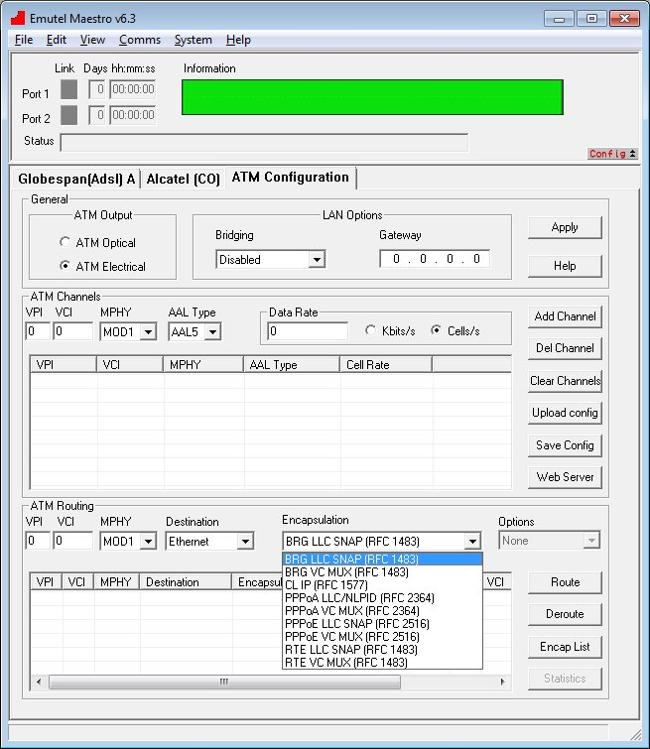
arcatech
…testing tomorrows telecoms
User Interface
A number of encapsulation methods are also supported.
For each data connection that is setup within the Maestro an encapsulation method can also be added.

Slide 12
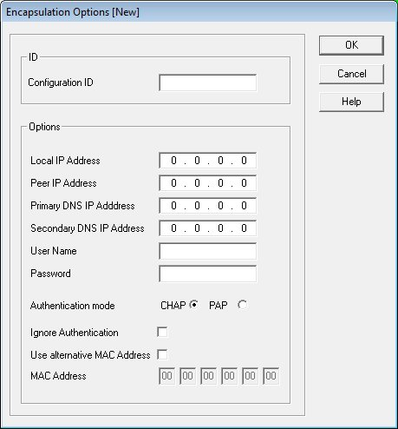
arcatech
…testing tomorrows telecoms
User Interface
Encapsulation options
For encapsulation options such as PPPoA and PPPoE, the required IP addresses for the local and Peer can be setup.
A User Name and Password can also be added where authentication is required.

Slide 13
arcatech
…testing tomorrows telecoms
Thank You
arcatech Limited 210-212 LEO Ballinderry Road
Lisburn
Northern Ireland
BT28 2QA
Tel: +44 (0)28 9267 7204
Fax: +44 (0)28 9260 5353
sales@arcatech.com
www.arcatech.com

