Slide 1


arcatech
…testing tomorrows telecoms

Slide 2

arcatech
…testing tomorrows telecoms
Emutel Harmony applications
Terry Simpson
CEO of arcatech Ltd
E: tsimpson@arcatech.com

Slide 3

arcatech
…testing tomorrows telecoms
2. Introduction to Arcatech
Located in UK / Northern Ireland
Design, manufacture and support telecom testing equipment
Arcatech’s products have been providing test solutions for over
20 years
arcatech

Slide 4
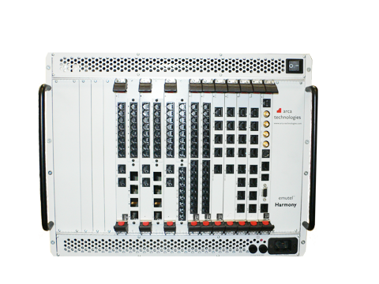
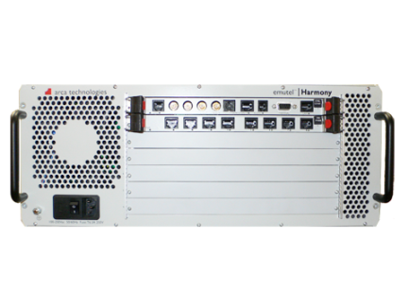

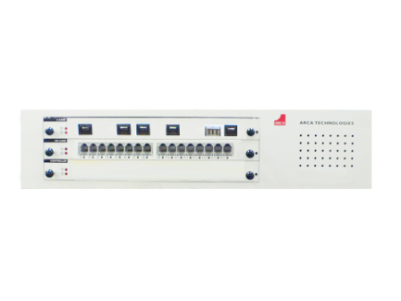
arcatech
…testing tomorrows telecoms
3. Current Harmony Product
soft|harmony
USB dongle
SIP / H.323 Bulk Call Generator
harmony|compact
1 card system
Network Simulation
Call Generation
VoIP, ISDN, POTS
harmony|developer
5 card system
Network Simulation
Call Generation
VoIP, ISDN, POTS
harmony|enterprise
15 card system
Network Simulation
Call Generation
VoIP, ISDN, POTS

Slide 5
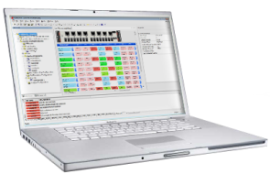
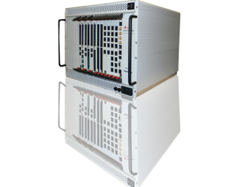
arcatech
…testing tomorrows telecoms
3. Current Harmony Product
BRI Euro-ISDN
ISDN Fax
emutel™ Harmony features:
BRI Card 8 ports (example)
  Multiple Interfaces supported in one system.
  Multiple protocols supported simultaneously on each line card.
  Ports configurable to be either Network or User side.
  Individual port configuration, allowing for multiple test scenarios in
  one script.
  Multiple units controlled as if they were all one.
BRI NTT
PESQ

Slide 6

arcatech
…testing tomorrows telecoms
3. Current Harmony Product
Available Cards:
BRI-S card – 8 ports each individually configurable to be either Network side or User side, using Local or Remote clocking and running one of a number of Network Protocols.
BRI-U card – 8 ports configurable to be either Network side or User side, using Local or Remote clocking and running one of a number of Network Protocols.
PRI card – 8 ports each individually configurable to be E1, T1 or J1, either Network side or User side, using Local or Remote clocking and running one of a number of Network Protocols.
FXO card – 16 ports which can be configured to operate using different country line parameters.
Multifunction card – 2xPRI and 8xFXO ports with the same functionality as the appropriate larger cards. ( FXS and BRI-S module optional )
LAN – 1U Chassis Server for better VoIP performance, up to 8 LAN ports per chassis ( multiple option available )

Slide 7
arcatech
…testing tomorrows telecoms
5. Applications and Solutions Build on Harmony
Interoperability Tests
Monitoring
Regression Tests
IMS Benchmark
Gateway testing

Slide 8

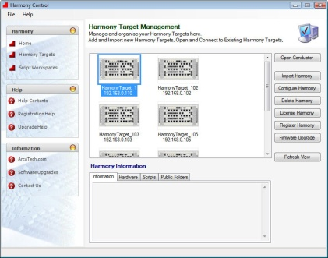
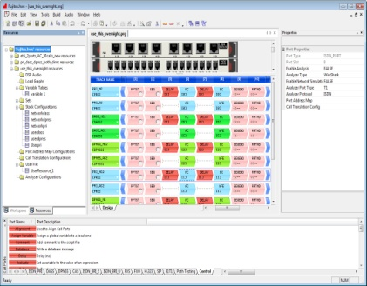

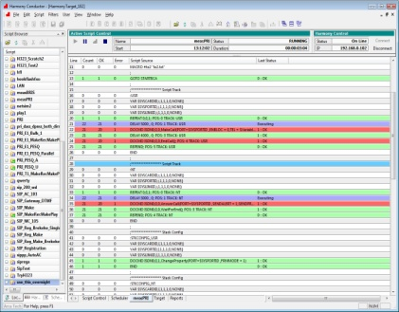
arcatech
…testing tomorrows telecoms
5. Applications and Solutions Built on Harmony
Gateway Testing
In this emutel Harmony is being used in a wrap around scenario to test an IP gateway. The windows application provides ease of script writing and configuration, and also analysis of the call being made.
Configuration PC
IP Gateway
SIMULATOR
Emutel™ Harmony

Slide 9













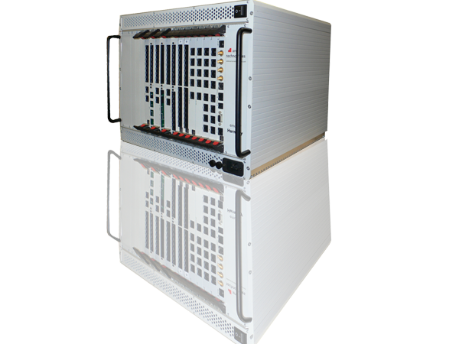






arcatech
…testing tomorrows telecoms
5. Applications and Solutions Built on Harmony
Regression Testing
Many equipment manufacturers are using manual testing as a way to prove their equipment. This is costly and it is also difficult to maintain high standards of repeatability of test scenarios. Through the project life cycle new software releases and upgrades need to be repeatedly and rigorously validated to ensure that the product does not loose functionality of stability as a result of the developments.
Version 3.3
Version 3.2
Version 3.1
Version 3.0
Version 2.5
Version 2.6
Version 2.4
Version 2.3
Version 2.2
Version 2.1
Version 1.0
Version 2.0
Version 1.2
Version 1.1
Version 1.3

Slide 10

arcatech
…testing tomorrows telecoms
5. Applications and Solutions Built on Harmony
IMS Benchmark
IMS
AGCF
SIP loop
AGW
POTS
POTS
SIMULATOR
Emutel™ Harmony

Slide 11


arcatech
…testing tomorrows telecoms
5. Applications and Solutions Built on Harmony
Monitoring
Concept: Test the whole network:
cloud web server
WAN
PC
deploy commands
connect to server
User management, Control & Synchronise units,
Script deployment, Scheduler, Firmware upgrade, Unit authorisation, License management
View Reports, Set up notifications
Administer units under test, Remote testing
request commands
Network
ISDN, VoIP, POTS
Network
ISDN, VoIP, POTS
Key:
TCP Protocol
Network Traffic
Vienna
Graz
Linz
Scripts on unit run & information is sent back to server
Each harmony unit can work together or independently

Slide 12
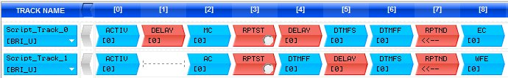
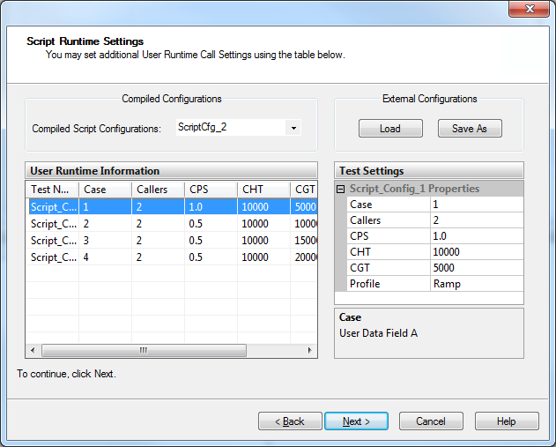
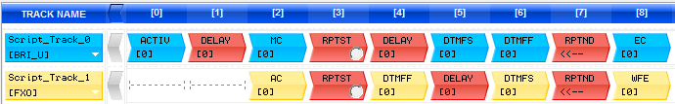
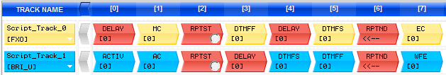
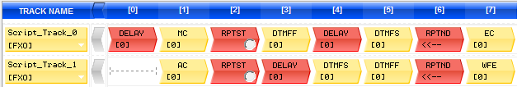
arcatech
…testing tomorrows telecoms
5. Applications and Solutions Built on Harmony
Mixed test Cases
  The different test cases required can be
  combine into one script.
  Ability to specify the number of calls, call rate,
  hold time and guard time for each individual test
  case.
  Facility to save particular test configurations to
  be used later for regression testing

Slide 13
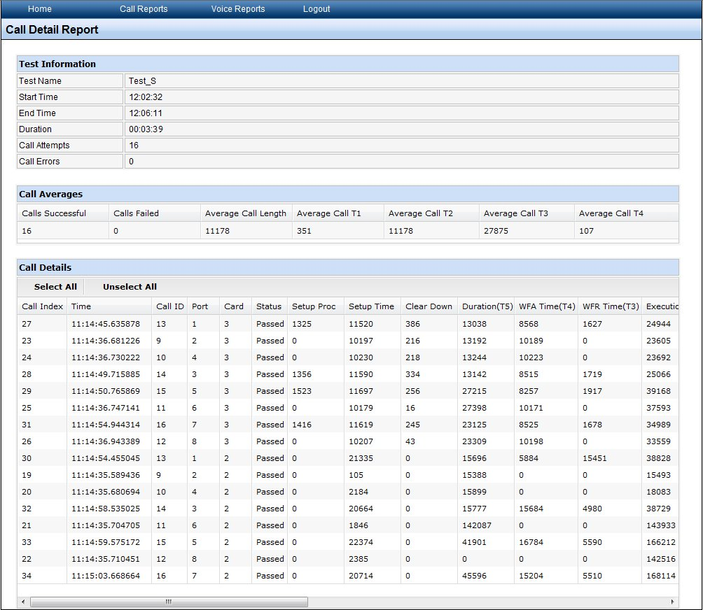
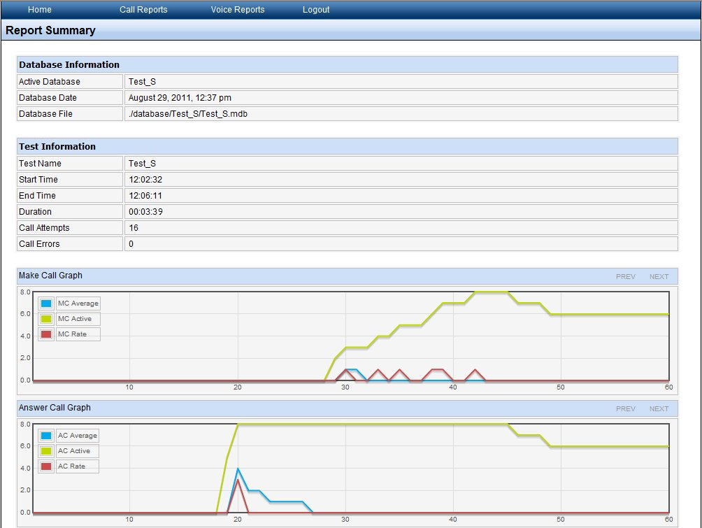
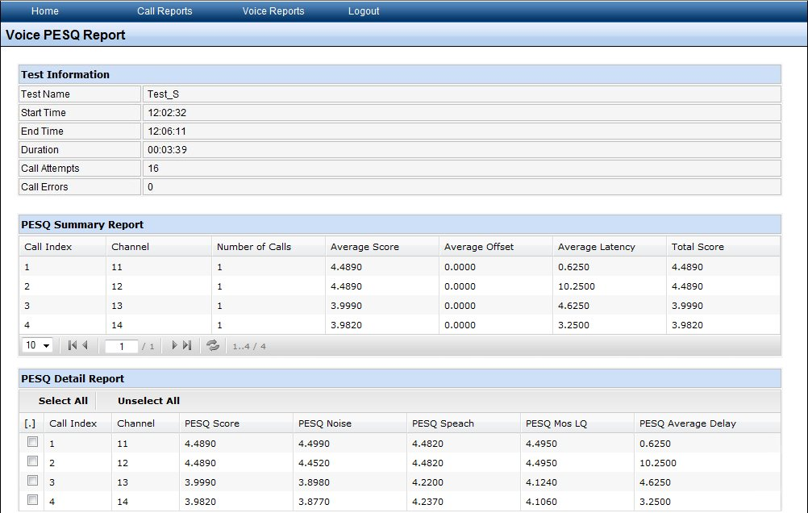
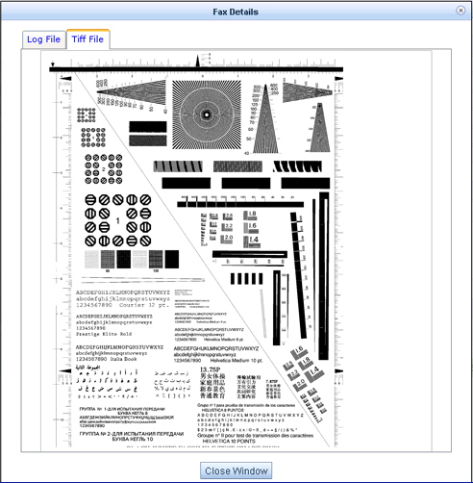
arcatech
…testing tomorrows telecoms
5. Applications and Solutions Built on Harmony
Reports
  Reports can be generated for each test carried out on the Harmony.
  Summary Reports :
  Test duration, Calls Attempts, Call Errors
  Detail Reports :
  Details of port used, Setup time, Called Party, Calling Party numbers, Call duration, Setup through time, time for Setup message to be transmitted through system under test.
  PESQ Reports :
  PESQ score, System through Delay
  FAX reports :
  Details, Quality, Image

Slide 14
arcatech
…testing tomorrows telecoms
Thank You
Arctech Ltd
www.arcatech.com
arca@arcatech.com
+44 (0) 2892 677204

