Slide 1
ISDN PRODUCT GUIDE
emutel|Duo
arcatech Limited
Unit 402 LEO Ballinderry Road
Lisburn
Northern Ireland
BT28 2QA
Tel: +44 (0)28 9267 7204
Fax: +44 (0)28 9260 5353
sales@arcatech.com
www.arcatech.com

Slide 2
Presentation Content
Solutions from arcatech Limited
Who is the emutel range used by
emutel|Duo features
Summary of features
Typical Applications
Other Products available from arcatech

Slide 3
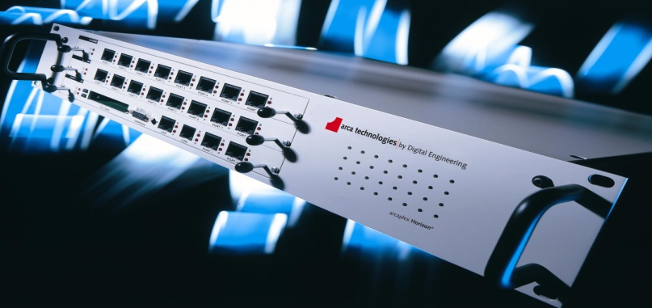
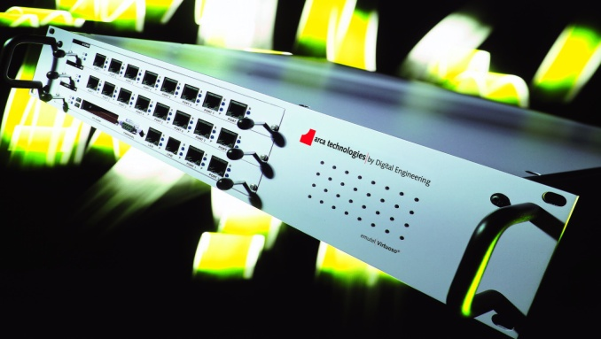
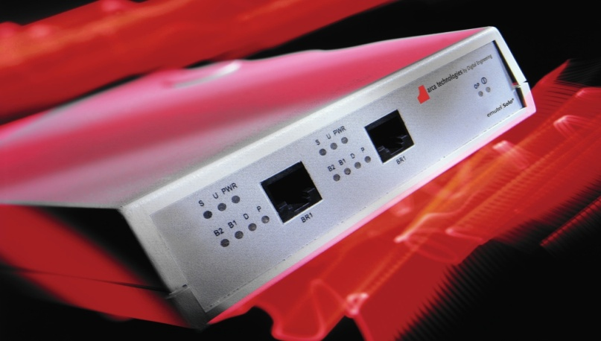
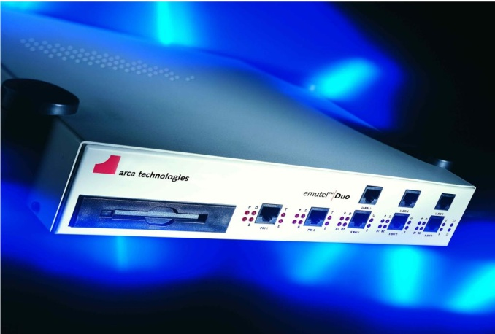
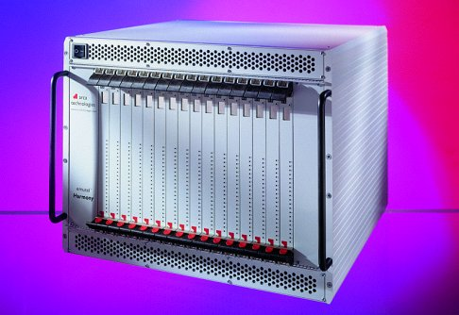
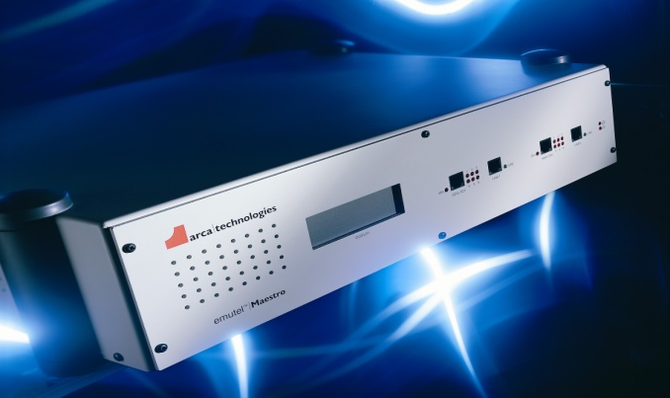
Solutions from arcatech Limited
ISDN
POTS
V5
xDSL
VoIP
Horizon
Symphony
Solo
Duo
Harmony
Maestro
Harmony

Slide 4











Typical Customers

Slide 5
The emutel range is used by
Developers
  ISDN
  xDSL
  VoIP
Production Line Testing
TE equipment
  Modems
  SIP/H.323 Gateway
Repair Houses
Confirm operation
For ISDN Network provision
Exhibitions/Shows
  Teaching facilities
  Labs

Slide 6
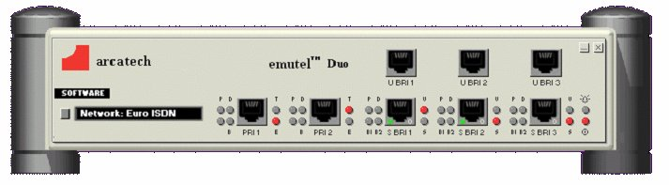
emutel|Duo – Primary & Basic Rate ISDN Network Simulator
A (2 Ports)
B (3 Ports)

Slide 7
Unit Features
BRI Ports
3 Ports, each switchable between BRI-S and BRI-U
PRI Ports
2 Ports, each switchable between E1 and T1
BRI Interface power
40V, 1W Normal and Restricted on BRI-S
88V, 5W Normal and Sealing on BRI-U
Network Variants
Support for ETSI, N.American, NTT, BTNR191, 1TR6, VN3
Protocol Analyser
Shows the L1, L2 & L3 messages on the D channel in HEX, ACSII Short and
ASCII Long

Slide 8
Unit Features
D Channel Packets
X.25 on BRI1/BRI2
100 logical calls in DCE mode
Semi-permanent connection
Semi-permanent/nailed-up connection on BRI/PRI B channels
X21
Allows external test equipment to be connected to the B channels while in NT
mode.
P-P / P-MP
Point-to-point or point-to-multipoint modes can be selected
Parallel Monitoring
Allows the unit to be inserted between a piece of user equipment & a network, for
protocol analysis purposes

Slide 9
Unit Features
Clock Synchronisation
Allows the unit to supply a reference clock to another unit OR receive an external
reference clock from an external device
Supplementary services
Mainly on the ETSI & N.American networks
Extra add-on features like 3PTY CONF, ECT, HOLD, CFU, CFB, CFNR, CD,
MCID, AOC, CW, etc.
Telephone no. setup
Allows telephone numbers to be setup for the various ports
Also allows different numbering schemes to be used (i.e. MSN, normal, DDI &
auxiliary)
Test Tones
Dial, Busy, Error, Ring and Custom Tone 300Hz – 3400Hz @ +3dBm to -26dBm

Slide 10
Unit Features
Port Indicators
Interface type (E1/T1, S/U), P(Physical), D(Datalink) and B channel
Windows Application
Proprietary windows application, allowing simple changing/saving of unit settings & easy filtering of protocol analysis, etc.
Ethernet
An Ethernet port to allow connection to the unit via a LAN
Modem
An optional modem that allows the unit to be connected to a POTS network, for remote connection
Universal PSU (110/240 V)
Auto detecting PSU - no changes required to alter voltage input, can be used in different countries

Slide 11
Summary of Features….

Slide 12
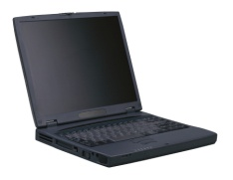

Typical Application
In this example, an emutel|Duo is providing network interfaces to verify the operation of a piece of customers equipment. The windows application provides ease of configuration and Protocol Analysis
ISDN Modem
ISDN Modem

Slide 13
Other products available from arcatech
emutel|Harmony
VoIP
ISDN
FXO
FXS
emutel|Symphony
FXS
ISDN
emutel|Duo
ISDN
arcaplex|Horizon
Multiplexer
ISDN
FXS
emutel|Maestro
xDSL
arcareach|Sigma
BRI-S bus extender

Slide 14
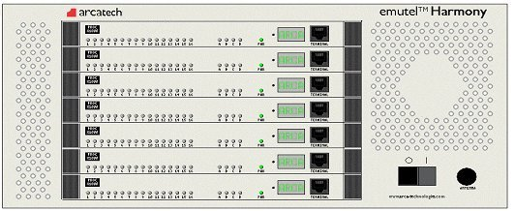
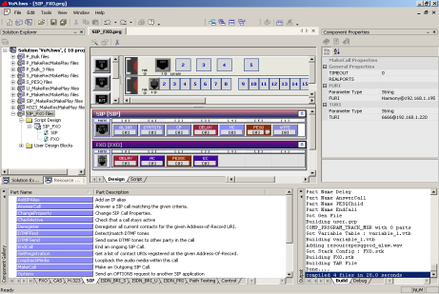
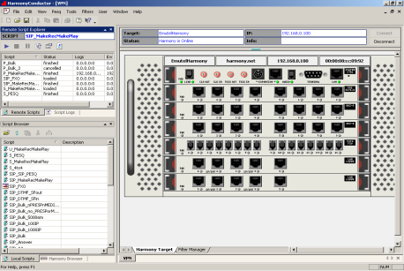
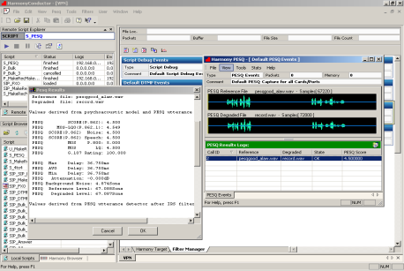
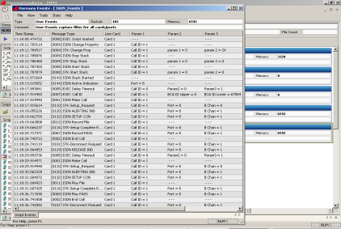
emutel|Harmony
Integrated VoIP & TDM Test Platform
High Port Density
VoIP, BRI, PRI, LAN, FXO, FXS
ETSI, North American, NTT, SIP, H.323
Quality of Service (PESQ)
Protocol Analysis
Call Generation
Call Termination
Network Simulation
Composer
Conductor
Events &
Statistics
PESQ

Slide 15
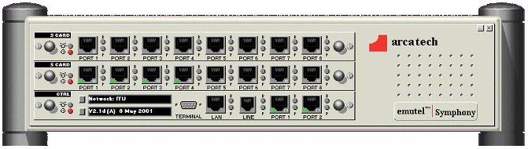
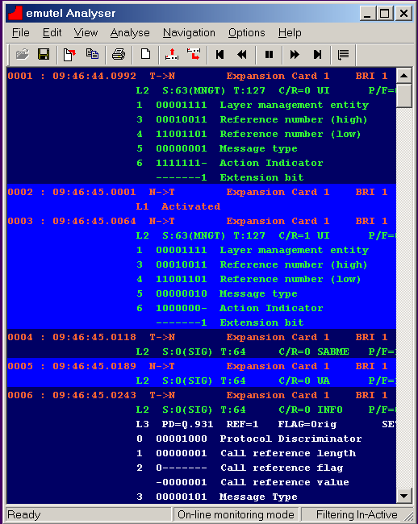
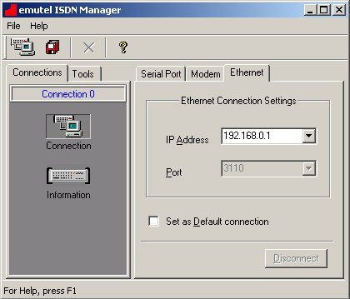
emutel|Symphony
Medium Port Density
ISDN support, both BRI and PRI
Analogue FXS support
Support for Network Variants
Protocol Analyser
Remote configuration
Windows Application driven
Analyser
Connection configuration

Slide 16
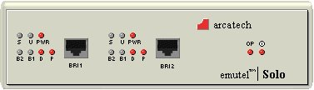
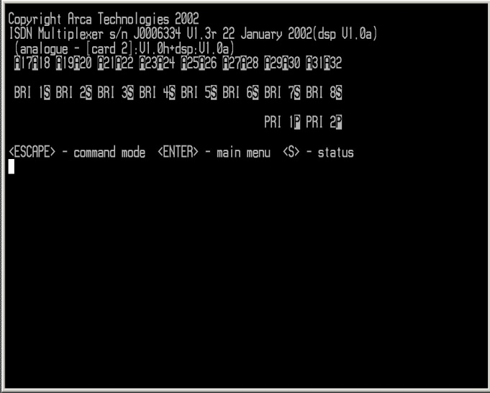
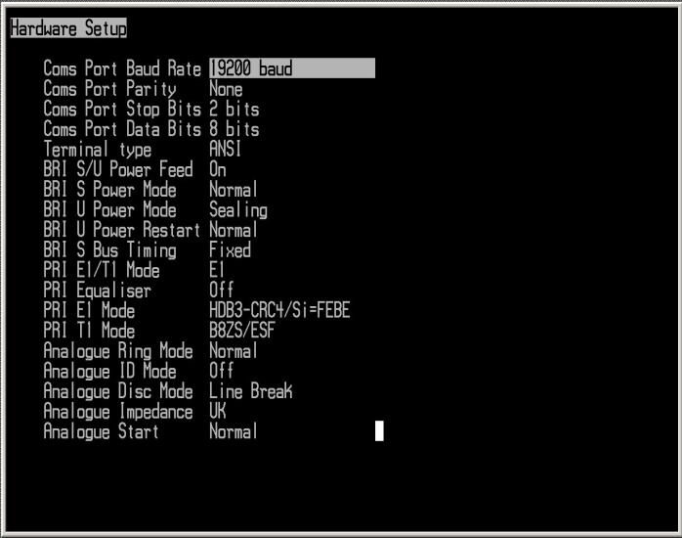
emutel|Solo
Low Port Density
ISDN support for BRI
Support for Network Variants
Configuration via
Terminal program

Slide 17
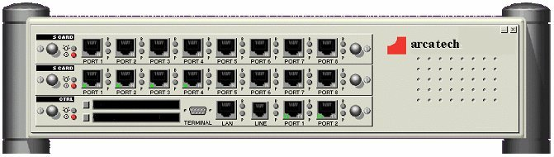
arcaplex|Horizon
PRI – ISDN/Analogue Multiplexer
Allows an E1 or T1 Network to be used with up to
16xBRI or 32xAnalogue phones
PRI network port allows for connection to another
Horizon or PRI TE equipment
CLI Interface

Slide 18
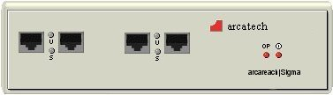
arcareach|Sigma
Converts BRI-S to BRI-U
When used in conjunction with an NT-1
enabling the extension of an S-bus up to 5.5km

Slide 19
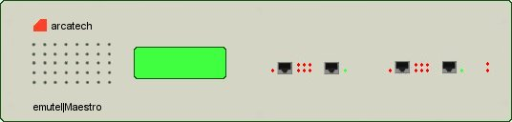
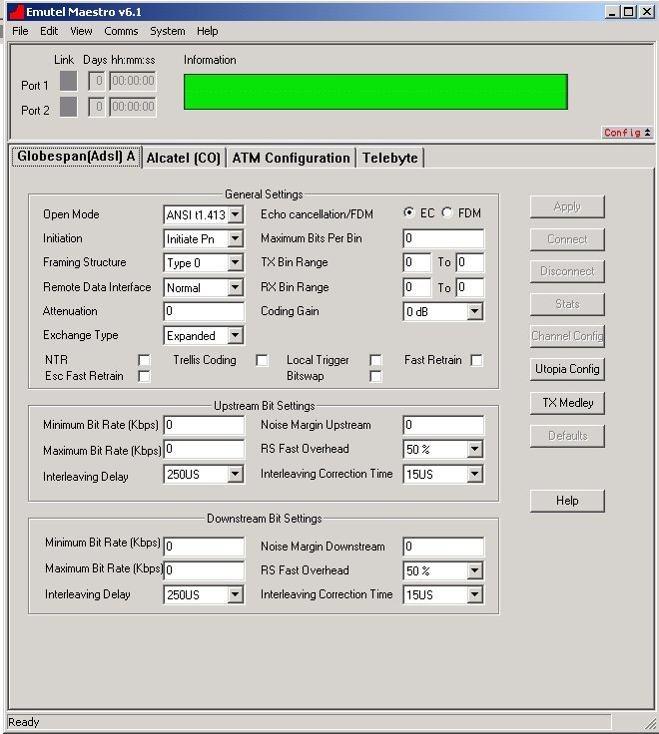
emutel|Maestro
Support for
ADSL (Annex A,B,C)
SHDSL
VDSL
Data Sources
ATM
Ethernet
Internal Web server
Windows Application
Configuration of Bandwidth,
upstream and downstream
Windows Application

Slide 20
The End

