Slide 1
arcatech
…testing tomorrows telecoms
arcaplex|Horizon presentation

Slide 2
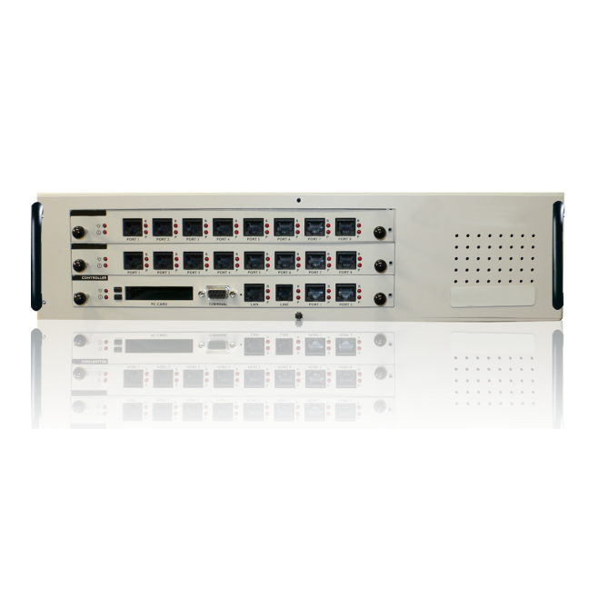
Unit Operation
The arcaplex|Horizon is a PRI to BRI or Analogue Multiplexer.
A PRI line coming in from the network provider is connected to the arcaplex|Horizon’s TE PRI port on the controller card. Incoming calls from the network provider are then assigned to particular ports on the arcaplex|Horizon either by the telephone number that the call is addressed to, or the timeslot in which the call is received.
A second PRI port operating in NT mode allows for connection of other PRI equipment to the arcaplex|Horizon. This can either be a PBX or perhaps a second arcaplex|Horizon.

Slide 3
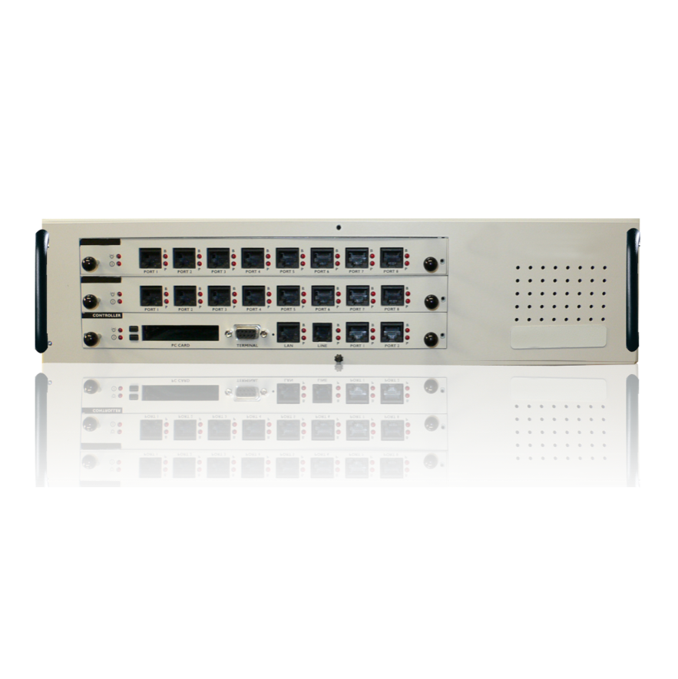
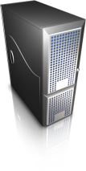
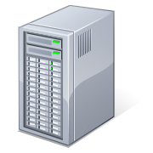
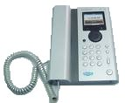
Example Application
In this example, an arcaplex|Horizon is used to provide the required BRI interfaces for Video Conferencing Equipment. The 3 BRI ports used are combined onto a PRI line which comes from the network operator (e.g. BT).
The remaining channels on the PRI are passed onto the office PBX for the rest of the office telephones.
Video Conferencing
Equipment
Network Operator
PBX
Phone

Slide 4
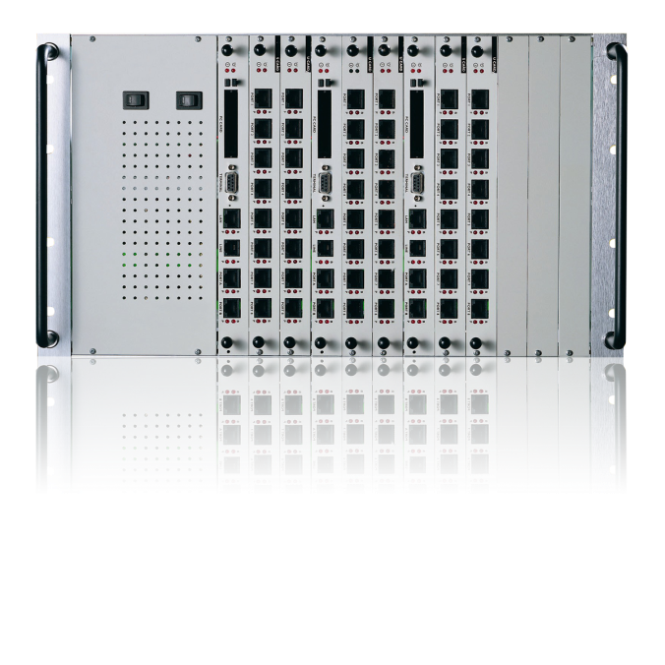
Chassis Options
C
B
A
2U chassis
6U chassis
2U chassis | Chassis | 6U chassis
2xPRI (E1 or T1) | Card Slot A (Controller card) | 2xPRI (E1 or T1)
8xBRI-S (or) 8xBRI-U (or) 16xAnalogue | Card Slot B | 8xBRI-S (or) 8xBRI-U (or) 16xAnalogue
2 card slots per system | Card Slot C | 6 card slots per system
ETSI, National ISDN | Protocol Support | ETSI, National ISDN
Protocol Analysis of running Network Protocol | Protocol Analysis | Protocol Analysis of running Network Protocol

Slide 5
Available Cards
Control card
Communication using either Serial, Ethernet or Modem connection.
The control card has 2x PRI ports, one for connection to a network provider (TE) and one for connection to other PRI equipment (NT).
BRI-S card
8 ports each individually configurable to have either 40V 1Watt power feeding, have restricted power feeding or to have power feeding turned off.
Ports can also be set to either Point–to–Point or Point–to–Multipoint operation.
BRI-U card
8 ports each individually configurable to have either 88V 5Watt power feeding, have Sealing power feeding (current limited) or to have power feeding turned off.
Ports can also be set to either Point–to–Point or Point–to–Multipoint operation.
Analogue card
16 ports which provide -48V line feed.
The port Line Impedance can be changed to match that of a number of countries, also tones can be changed to match the country selected.

Slide 6
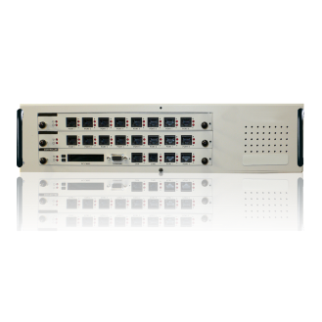
BRI-U vs BRI-S Comparison
Basic Rate ISDN (BRI) is divided into two forms, BRI-S and BRI-U. One of the main differences in them is the distance over which they can operate. BRI-S operates over the relatively short distance of 0.9km (3,000ft) where as BRI-U can operate up to 5.5km (18,000ft)
Many digital PBXs offer ISDN S-bus interfaces as standard. When there is a requirement for the S-bus to be located much further from the PBX then can be accommodated, the arcaplex|Horizon should be used with BRI-U interface!
NETWORK
BRI-U card
BRI-S card
BRI-S operates over the
relatively short distance of
0.9km (3,000ft)
BRI-U can operate
up to 5.5km (18,000ft)
NT-1
NT-1
NT-1
Office 1
Office 2
Office 3

Slide 7
Typical Application
In this example, an arcaplex|Horizon will be used to replace 15 x BRI lines from network provider with 1 x PRI.
The arcaplex|Horizon receives a PRI line from the network which it then feeds out as BRI to telephones in an office.
Office 1
NETWORK
15 BRI lines
PRI
network
PRI
15 BRI lines
Office 2
15 BRI lines
15 BRI lines
Office 1
Office 2

Slide 8
Unit Features
PRI encoding
E1 – AMI/HDB3, CRC-4 multi frame/basic frame
T1 – B8ZS, ESF
Network variants
Support for ETSI and North America
Hunting groups on PRI
Horizon can route the call to port 2 if port 1 is busy,
to port 3 if port 1 and 2 is busy etc..
Configuration connection
Connection can be through either RS-232, 10BaseT Ethernet or via Modem
Configuration interface
Configuration of the Horizon can be done through a menu system or CLI commands
Universal PSU
Auto detecting PSU - no changes required to alter voltage input, can be used in different countries
Voltage types
Both an AC (110-240 V) and DC (-36V to -72V) are available

Slide 9
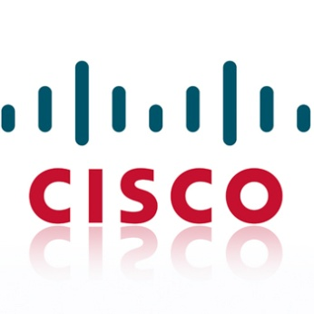
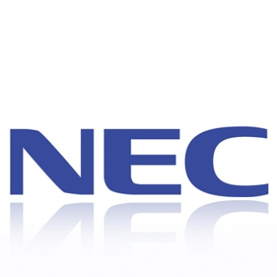
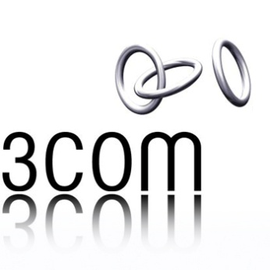
Typical Customers

Slide 10
Thank You
arcatech Limited 210-212 LEO Ballinderry Road
Lisburn
Northern Ireland
BT28 2SA
Tel: +44 (0)28 9267 7204
Fax: +44 (0)28 9260 5353
sales@arcatech.com
www.arcatech.com

